Slide 1

Forces and Trapping of Dust Particles
Patrick Brown
EUCOS Group
Baylor University

Slide 2
Overview
There are five main forces acting on dust particles in a plasma:
1. Gravity
2. Electric Field Force
3. Ion Drag Force
4. Thermophoresis
5. Neutral Drag
These forces cause vertical oscillations in the plasma sheath (dust region).
Note: Unless otherwise specified all equations are from [1].

Slide 3
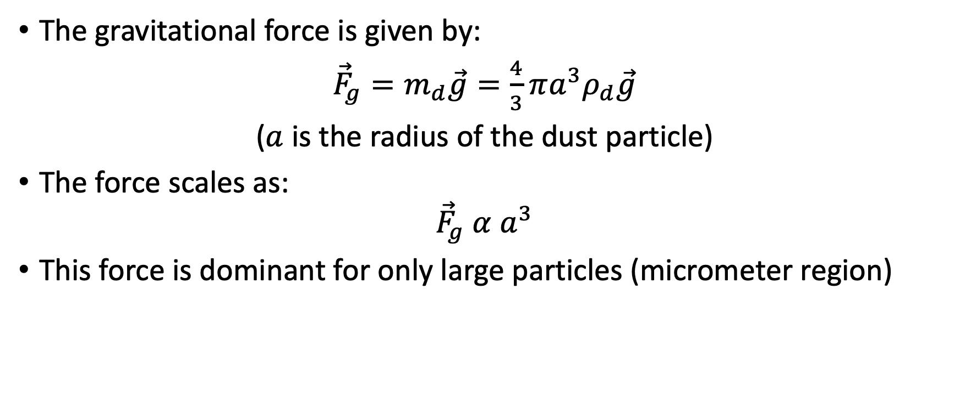
Gravity
The gravitational force is given by:
${\vec{F}}_{g}=m_{d}\vec{g}=\frac{4}{3}πa^{3}ρ_{d}\vec{g}$
($a$ is the radius of the dust particle)
The force scales as:
$${\vec{F}}_{g} α{ a}^{3}$$
This force is dominant for only large particles (micrometer region)

Slide 4
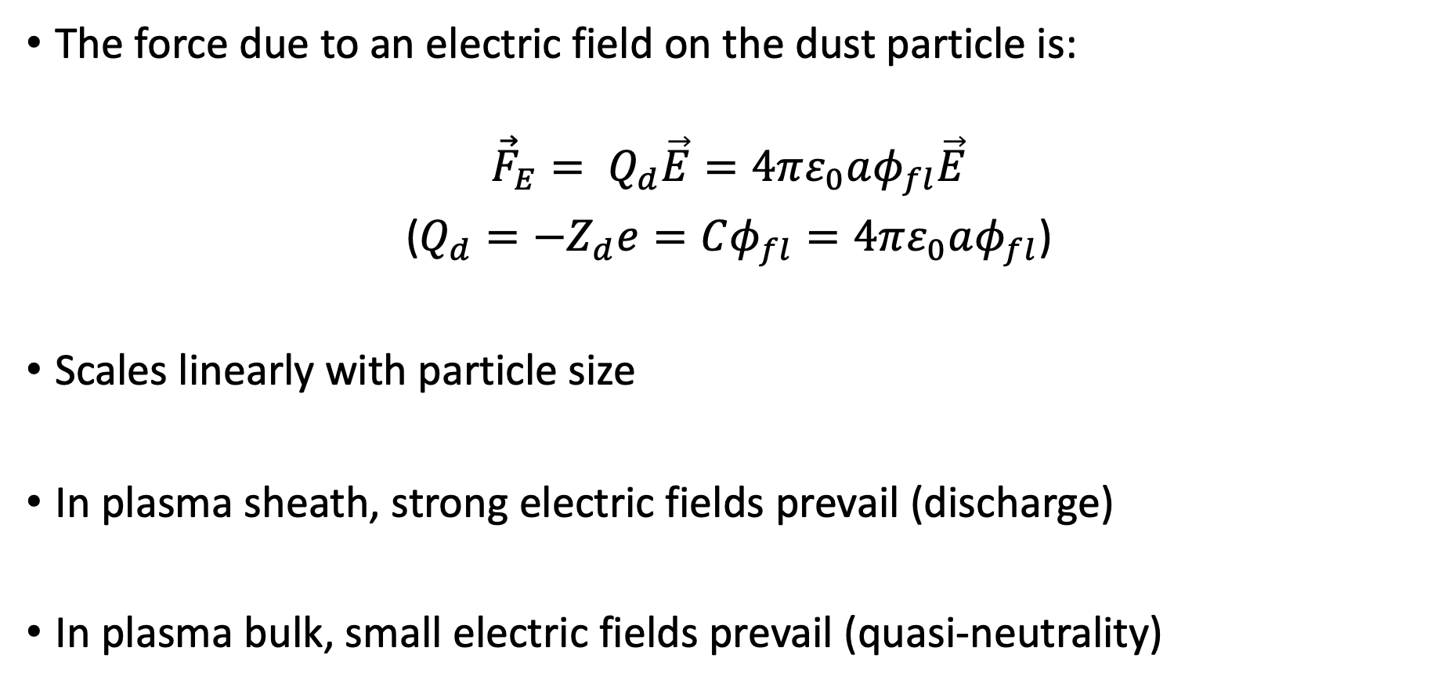
Electric Field Force
The force due to an electric field on the dust particle is:
$${\vec{F}}_{E}= Q_{d}\vec{E}=4πε_{0}aφ_{fl}\vec{E}$$
($Q_{d}=−Z_{d}e=Cφ_{fl}=4πε_{0}aφ_{fl}$)
Scales linearly with particle size
In plasma sheath, strong electric fields prevail (discharge)
In plasma bulk, small electric fields prevail (quasi-neutrality)

Slide 5
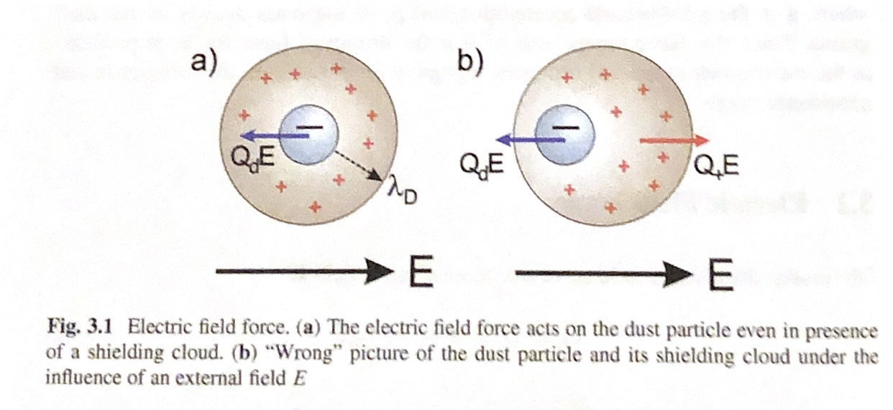
Shielding
Image Source [1].
Shielding cloud is formed as a result of dust particle’s electric field (and external electric field)
Shield reacts according to these fields
Shielding is therefore a response to the presence of the dust
If the dust particle moves then the cloud DOES NOT move with it; but instead vanishes at the original point and then reforms at the nest point
Therefore no counterforce to the electric field comes from the shielding

Slide 6
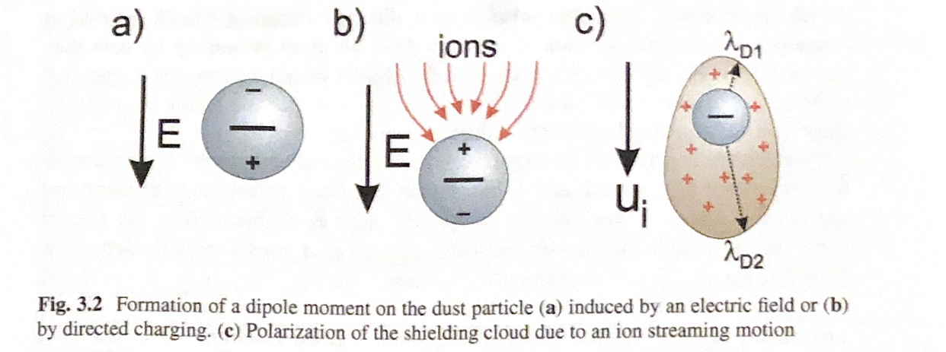
Polarization Force
Three types of polarization of dust particles
1. Induced by external electric field
2. Directed Charging
3. Polarization of Shielding Cloud
Image Source [1].

Slide 7
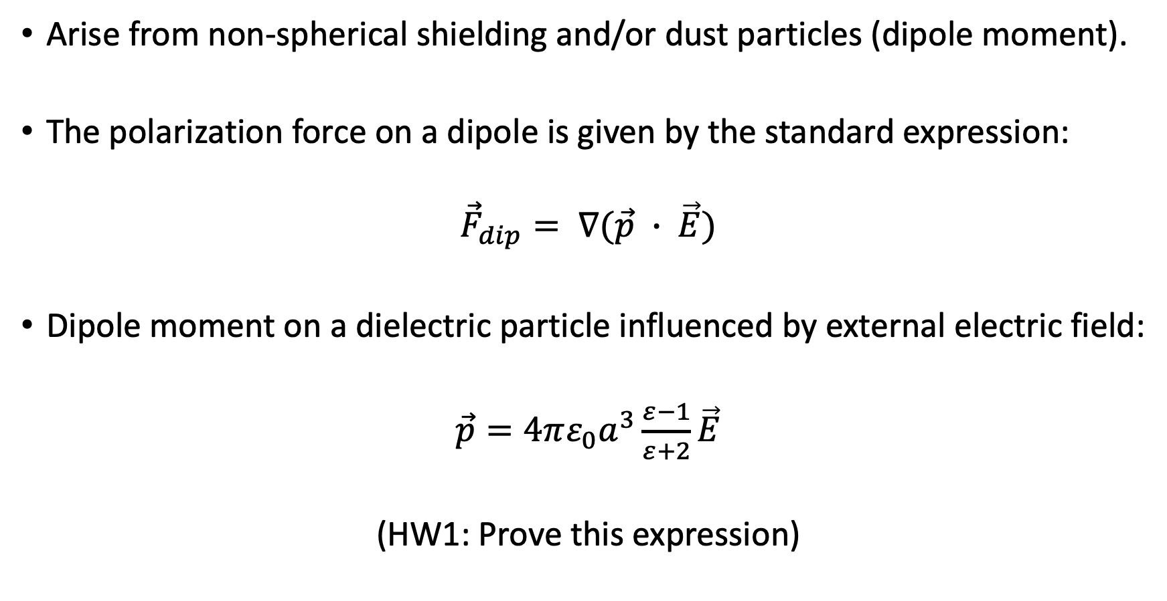
Polarization Force
Arise from non-spherical shielding and/or dust particles (dipole moment).
The polarization force on a dipole is given by the standard expression:
$${\vec{F}}_{dip}= ∇(\vec{p} ∙ \vec{E})$$
Dipole moment on a dielectric particle influenced by external electric field:
$\vec{p}=4πε_{0}a^{3}\frac{ε−1}{ε+2}\vec{E}$
(HW1: Prove this expression)

Slide 8
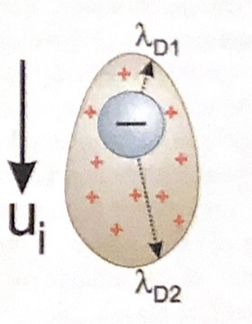
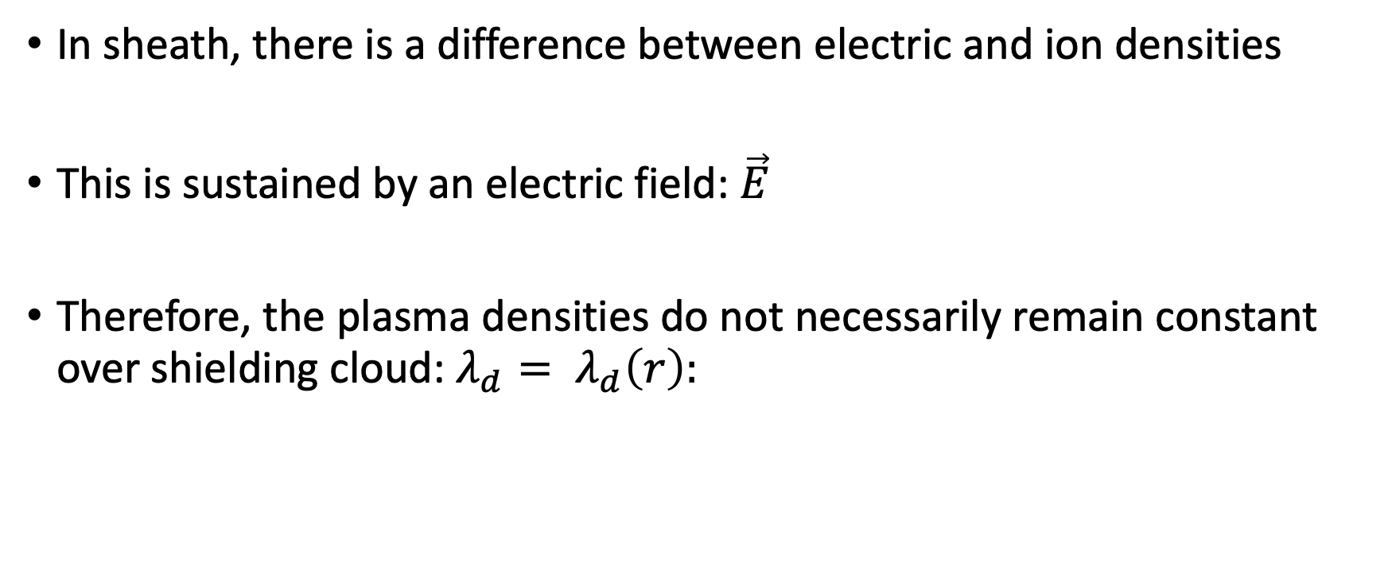
Polarization Force
In sheath, there is a difference between electric and ion densities
This is sustained by an electric field: $\vec{E}$
Therefore, the plasma densities do not necessarily remain constant over shielding cloud: $λ_{d}= λ_{d}\left(r\right):$
Image Source [1].

Slide 9
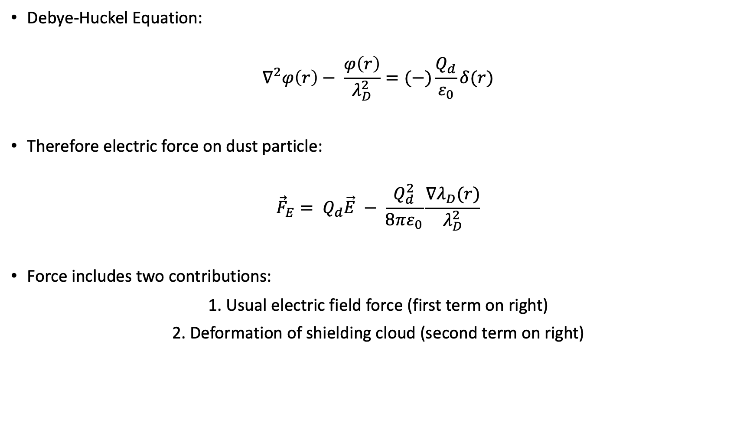
Polarization Force
Debye-Huckel Equation:
$$∇^{2}φ\left(r\right)− \frac{φ\left(r\right)}{λ_{D}^{2}}=(−)\frac{Q_{d}}{ε_{0}}δ(r)$$
Therefore electric force on dust particle:
$${\vec{F}}_{E}= Q_{d}\vec{E} − \frac{Q_{d}^{2}}{8πε_{0}}\frac{∇λ_{D}(r)}{λ_{D}^{2}}$$
Force includes two contributions:
1. Usual electric field force (first term on right)
2. Deformation of shielding cloud (second term on right)

Slide 10
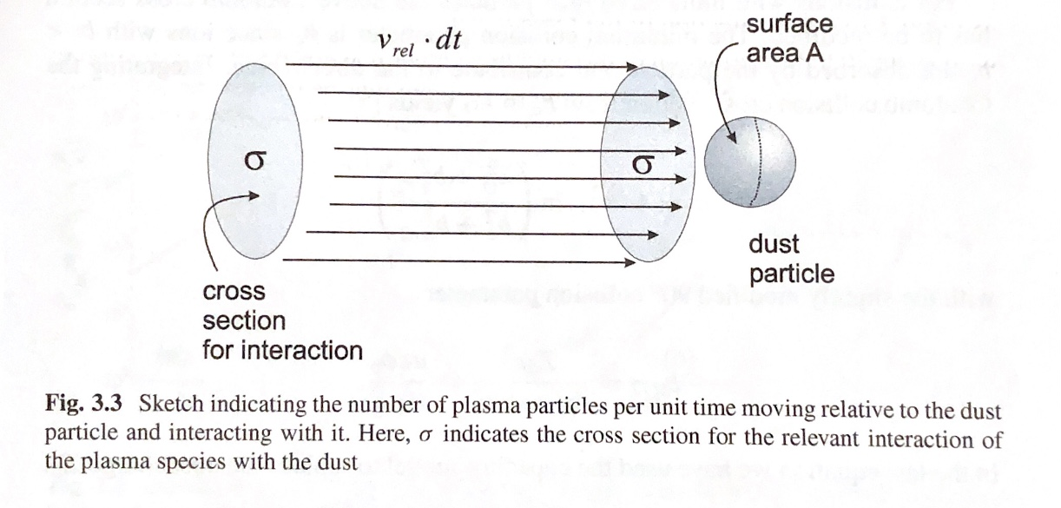
Ion Drag Force
Arise from motion of plasma relative to dust particle
Ion Drag: interaction is electrostatic
Neutral Drag: Interaction through collisions
Image Source [1].

Slide 11
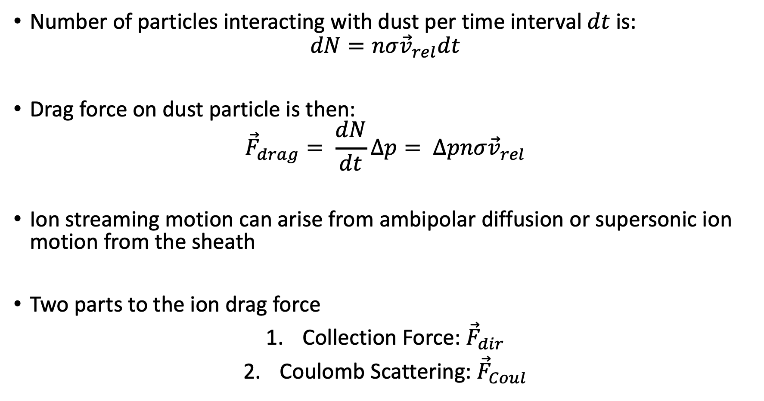
Ion Drag Force
Number of particles interacting with dust per time interval $dt$ is:
$$dN=nσ{\vec{v}}_{rel}dt$$
Drag force on dust particle is then:
$${\vec{F}}_{drag}= \frac{dN}{dt}∆p= ∆pnσ{\vec{v}}_{rel}$$
Ion streaming motion can arise from ambipolar diffusion or supersonic ion motion from the sheath
Two parts to the ion drag force
Collection Force: ${\vec{F}}_{dir}$
Coulomb Scattering: ${\vec{F}}_{Coul}$

Slide 12
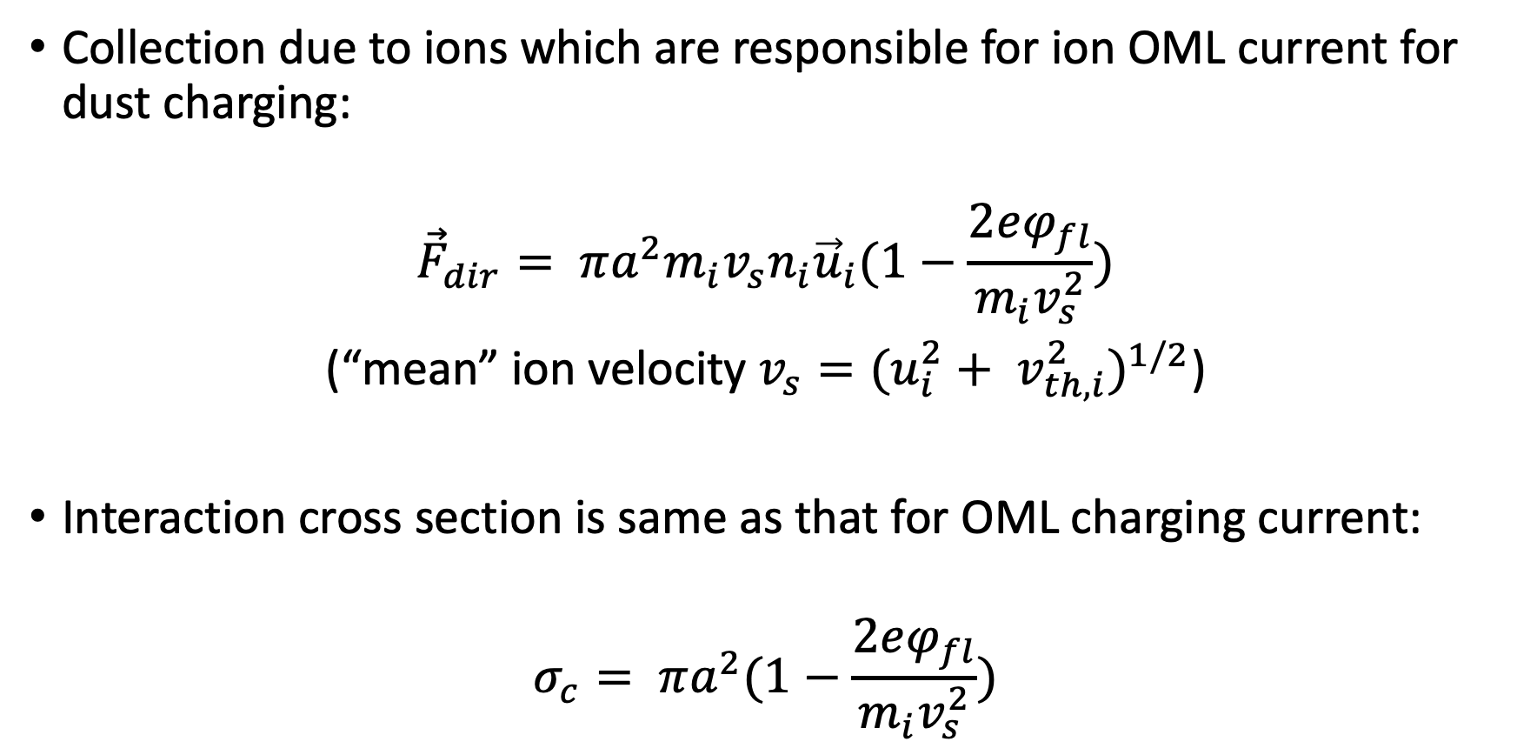
Barnes Model (Collection)
Collection due to ions which are responsible for ion OML current for dust charging:
$${\vec{F}}_{dir}= πa^{2}m_{i}v_{s}n_{i}{\vec{u}}_{i}(1−\frac{2eφ_{fl}}{m_{i}v_{s}^{2}})$$
(“mean” ion velocity $v_{s}=(u_{i}^{2}+ v_{th, i}^{2})^{1/2}$)
Interaction cross section is same as that for OML charging current:
$$σ_{c}= πa^{2}(1−\frac{2eφ_{fl}}{m_{i}v_{s}^{2}})$$

Slide 13
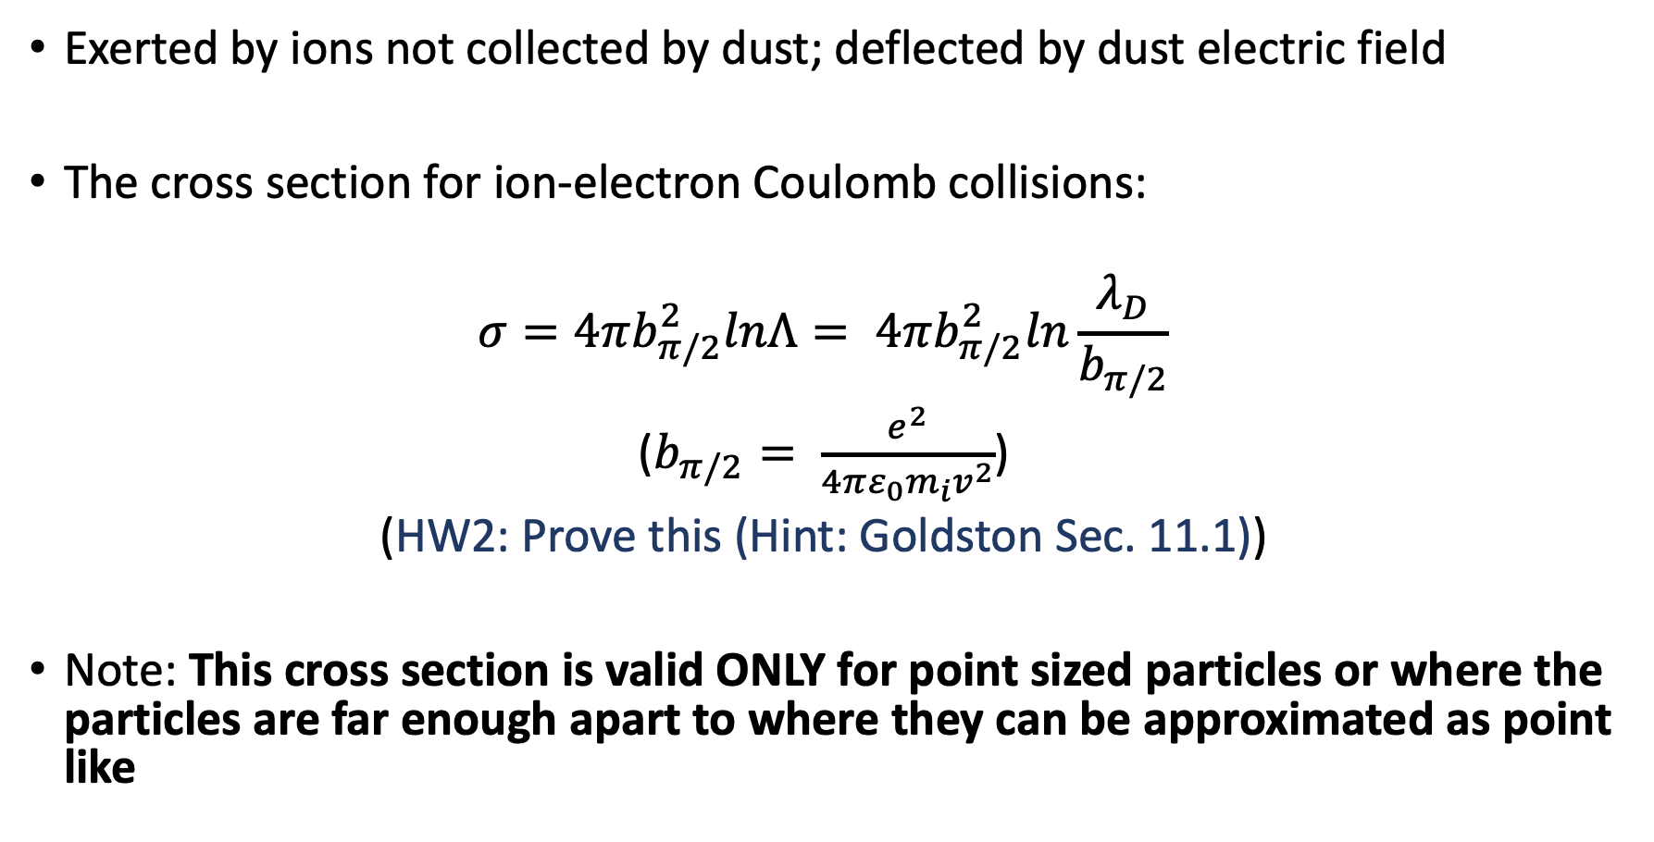
Barnes Model (Coulomb)
Exerted by ions not collected by dust; deflected by dust electric field
The cross section for ion-electron Coulomb collisions:
$$σ=4πb_{π/2}^{2}lnΛ= 4πb_{π/2}^{2}ln\frac{λ_{D}}{b_{π/2}}$$
($b_{π/2}= \frac{e^{2}}{4πε_{0}m_{i}v^{2}}$)
(HW2: Prove this (Hint: Goldston Sec. 11.1))
Note: This cross section is valid ONLY for point sized particles or where the particles are far enough apart to where they can be approximated as point like

Slide 14
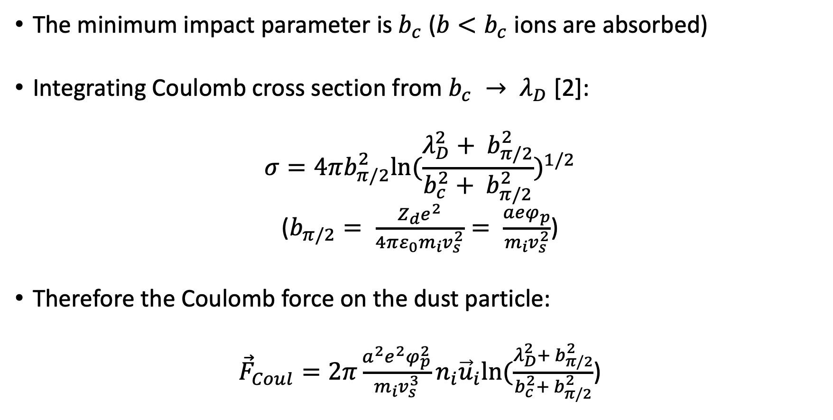
Barnes Model (Coulomb)
The minimum impact parameter is $b_{c}$ (${b<b}_{c}$ ions are absorbed)
Integrating Coulomb cross section from $b_{c} → λ_{D}$ [2]:
$$σ=4πb_{π/2}^{2}ln⁡(\frac{λ_{D}^{2}+ b_{π/2}^{2}}{b_{c}^{2}+ b_{π/2}^{2}})^{1/2}$$
($b_{π/2}= \frac{Z_{d}e^{2}}{4πε_{0}m_{i}v_{s}^{2}}= \frac{aeφ_{p}}{m_{i}v_{s}^{2}}$)
Therefore the Coulomb force on the dust particle:
${\vec{F}}_{Coul}=2π\frac{a^{2}e^{2}φ_{p}^{2}}{m_{i}v_{s}^{3}}n_{i}{\vec{u}}_{i}ln⁡(\frac{λ_{D}^{2}+ b_{π/2}^{2}}{b_{c}^{2}+ b_{π/2}^{2}}$)

Slide 15
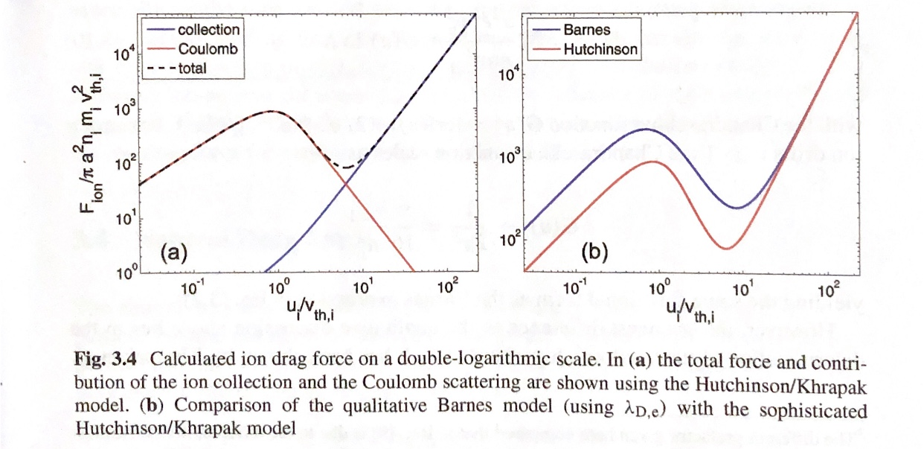
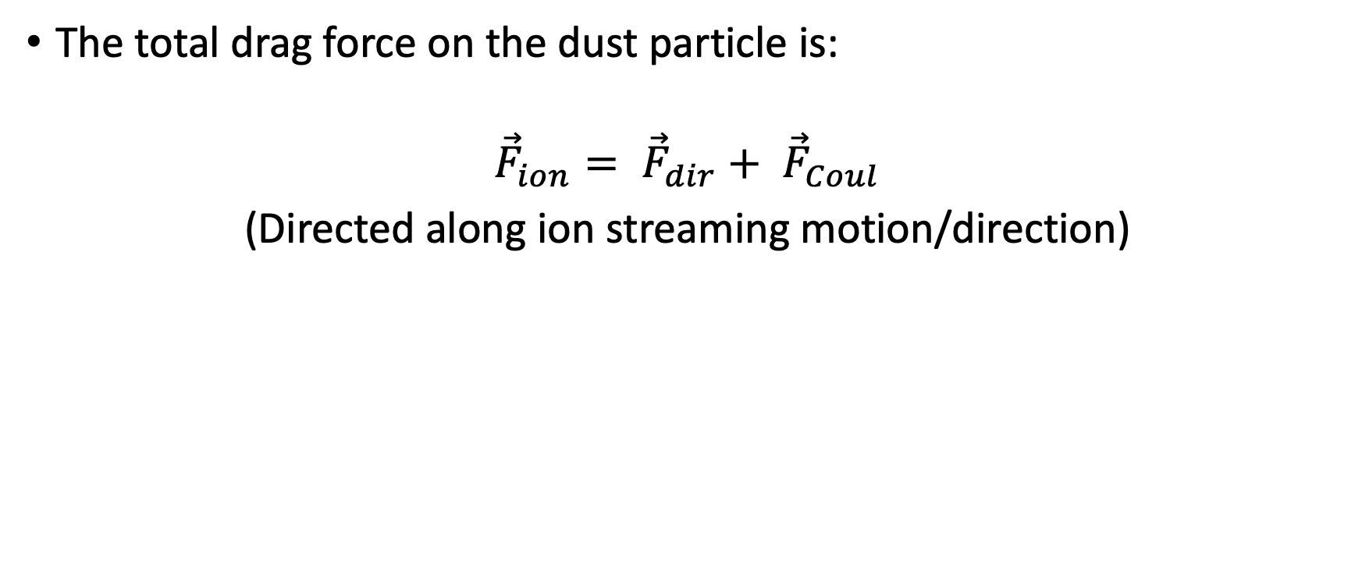
Barnes Model (Total)
The total drag force on the dust particle is:
$${\vec{F}}_{ion}= {\vec{F}}_{dir}+ {\vec{F}}_{Coul}$$
(Directed along ion streaming motion/direction)
Image Source [1].

Slide 16
Hutchinson/Khrapak Model
Must include highly charged dust grain Coulomb collisions outside Debye sphere must be included
Problem associated with what correct Debye length to use
Must also include the ion drift velocity in the total ion velocity as well: Shifted Maxwellian distribution

Slide 17
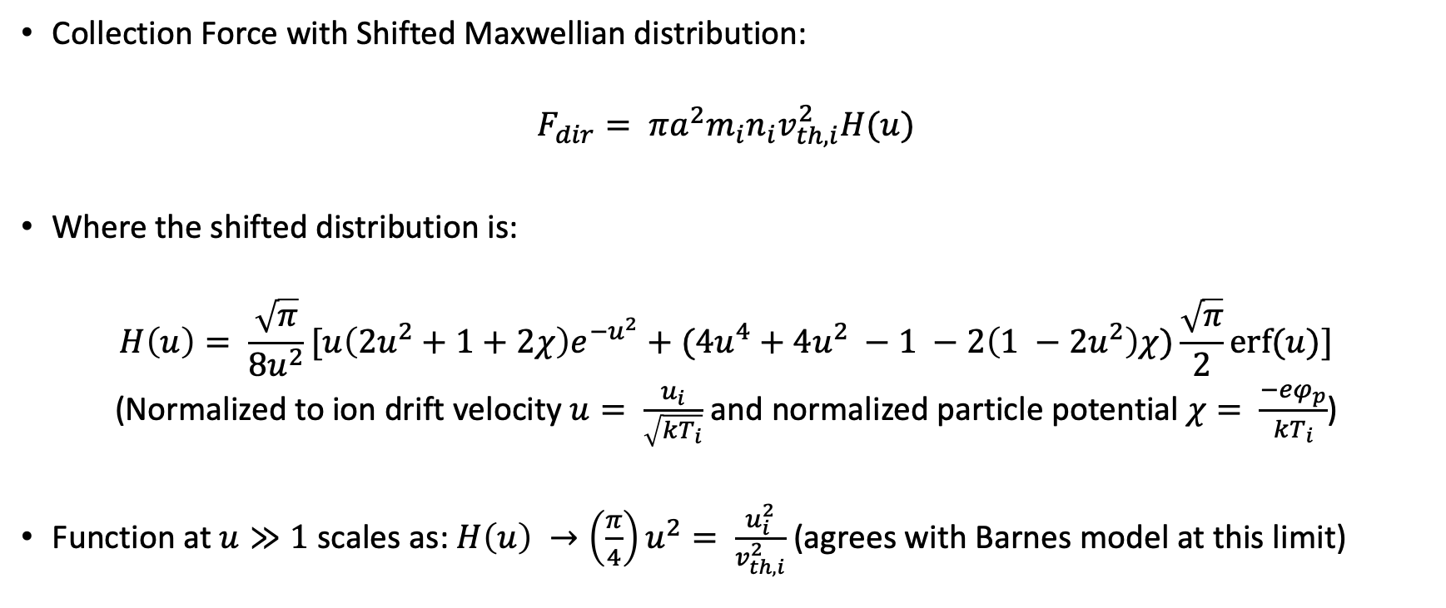
Hutchinson/Khrapak Model (Collection)
Collection Force with Shifted Maxwellian distribution:
$$F_{dir}= πa^{2}m_{i}n_{i}v_{th, i}^{2}H(u)$$
Where the shifted distribution is:
$$H\left(u\right)= \frac{\sqrt{π}}{8u^{2}}[u\left(2u^{2}+1+2χ\right)e^{−u^{2}}+(4u^{4}+4u^{2} −1 −2\left(1 −2u^{2}\right)χ)\frac{\sqrt{π}}{2}erf⁡(u)]$$
(Normalized to ion drift velocity $u= \frac{u_{i}}{\sqrt{kT_{i}}}$ and normalized particle potential $χ= \frac{−eφ_{p}}{kT_{i}}$)
Function at $u≫1$ scales as: $H\left(u\right) →\left(\frac{π}{4}\right)u^{2}= \frac{u_{i}^{2}}{v_{th, i}^{2}}$ (agrees with Barnes model at this limit)

Slide 18
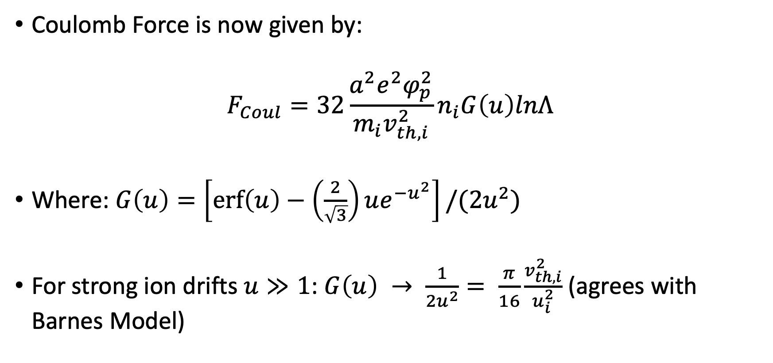
Hutchinson/Khrapak Model (Coulomb)
Coulomb Force is now given by:
$$F_{Coul}=32\frac{a^{2}e^{2}φ_{p}^{2}}{m_{i}v_{th,i}^{2}}n_{i}G\left(u\right)lnΛ$$
Where: $G\left(u\right)=\left[\operatorname{erf}\left(u\right)−\left(\frac{2}{\sqrt{3}}\right)ue^{−u^{2}}\right]/(2u^{2})$
For strong ion drifts $u≫1$: $G\left(u\right) → \frac{1}{2u^{2}}= \frac{π}{16}\frac{v_{th, i}^{2}}{u_{i}^{2}}$ (agrees with Barnes Model)

Slide 19
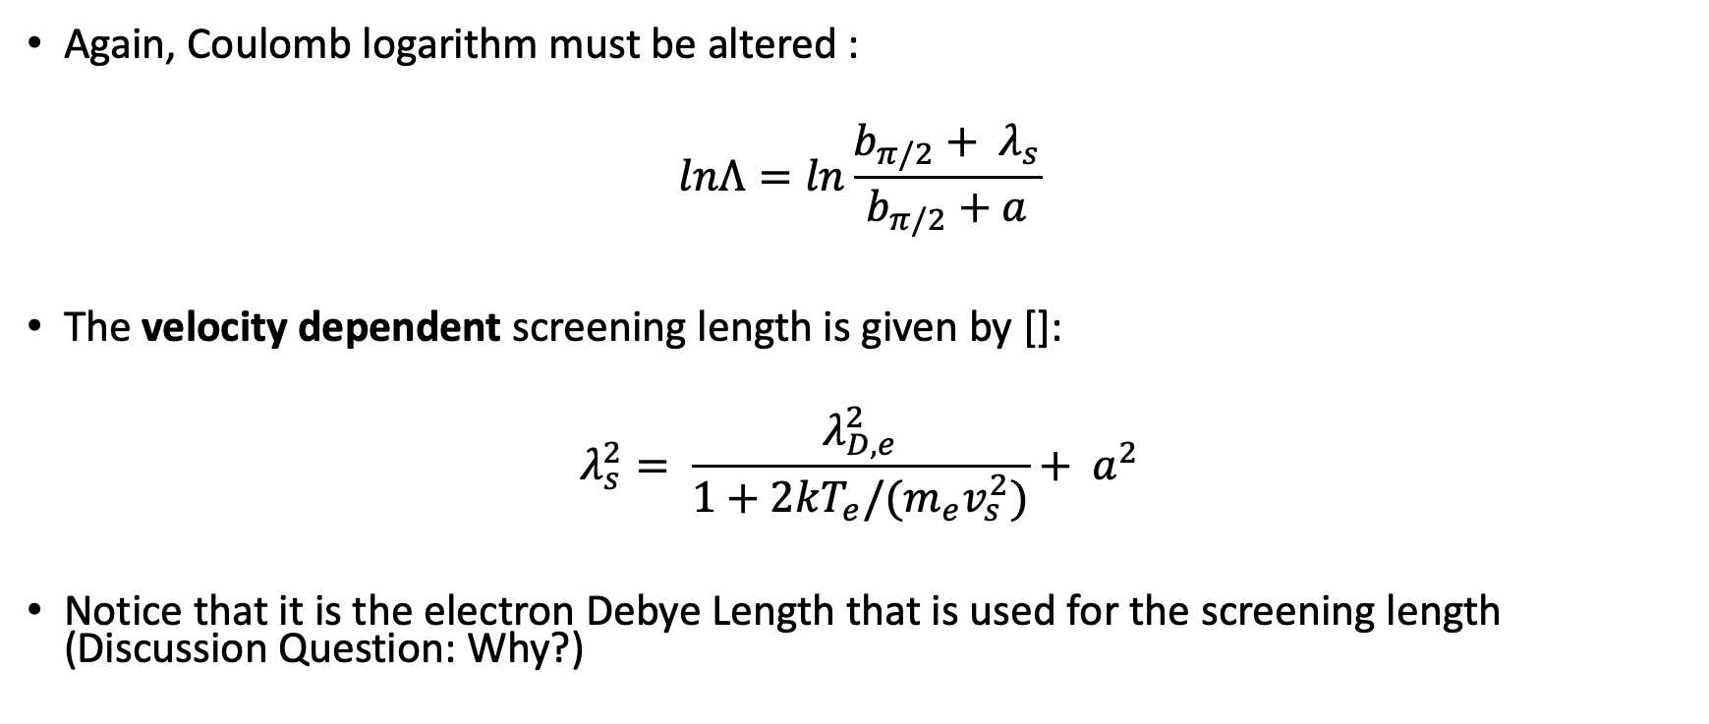
Hutchinson/Khrapak Model (Coulomb)
Again, Coulomb logarithm must be altered :
$$lnΛ=ln\frac{b_{π/2}+ λ_{s}}{b_{π/2}+a}$$
The velocity dependent screening length is given by []:
$$λ_{s}^{2}= \frac{λ_{D,e}^{2}}{1+2kT_{e}/(m_{e}v_{s}^{2})}+ a^{2}$$
Notice that it is the electron Debye Length that is used for the screening length (Discussion Question: Why?)

Slide 20
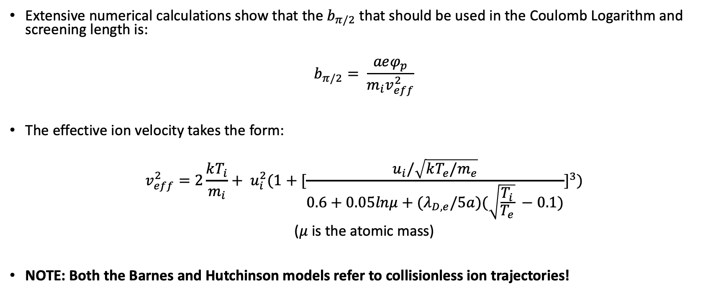
Hutchinson/Khrapak Model
Extensive numerical calculations show that the $b_{π/2}$ that should be used in the Coulomb Logarithm and screening length is:
$$b_{π/2}= \frac{aeφ_{p}}{m_{i}v_{eff}^{2}}$$
The effective ion velocity takes the form:
$$v_{eff}^{2}=2\frac{kT_{i}}{m_{i}}+ u_{i}^{2}(1+[\frac{u_{i}/\sqrt{kT_{e}/m_{e}}}{0.6+0.05lnμ+(λ_{D,e}/5a)(\sqrt{\frac{T_{i}}{T_{e}}} −0.1)}]^{3})$$
($μ$ is the atomic mass)
NOTE: Both the Barnes and Hutchinson models refer to collisionless ion trajectories!

Slide 21
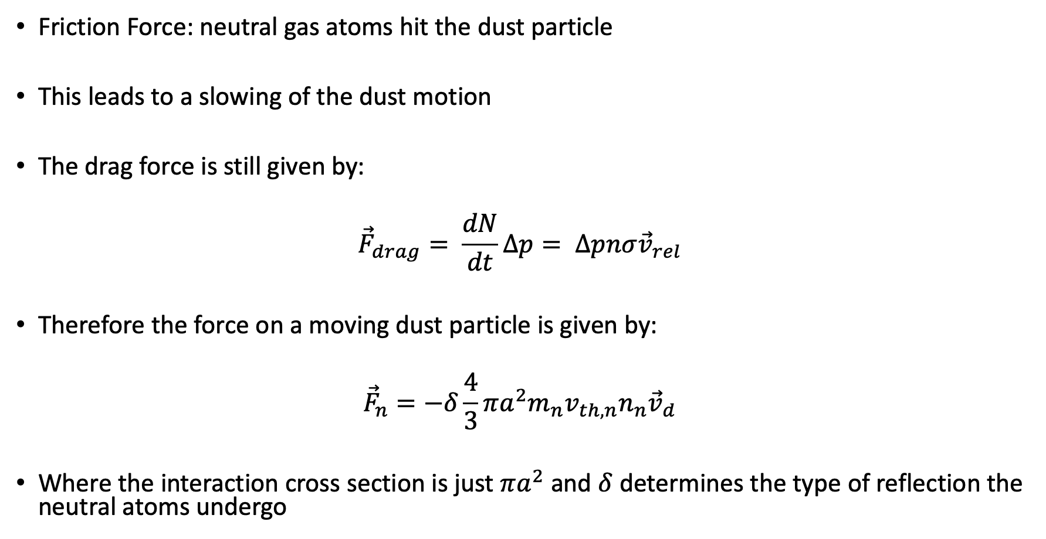
Neutral Drag Force
Friction Force: neutral gas atoms hit the dust particle
This leads to a slowing of the dust motion
The drag force is still given by:
$${\vec{F}}_{drag}= \frac{dN}{dt}∆p= ∆pnσ{\vec{v}}_{rel}$$
Therefore the force on a moving dust particle is given by:
$${\vec{F}}_{n}=−δ\frac{4}{3}πa^{2}m_{n}v_{th, n}n_{n}{\vec{v}}_{d}$$
Where the interaction cross section is just $πa^{2}$ and $δ$ determines the type of reflection the neutral atoms undergo

Slide 22
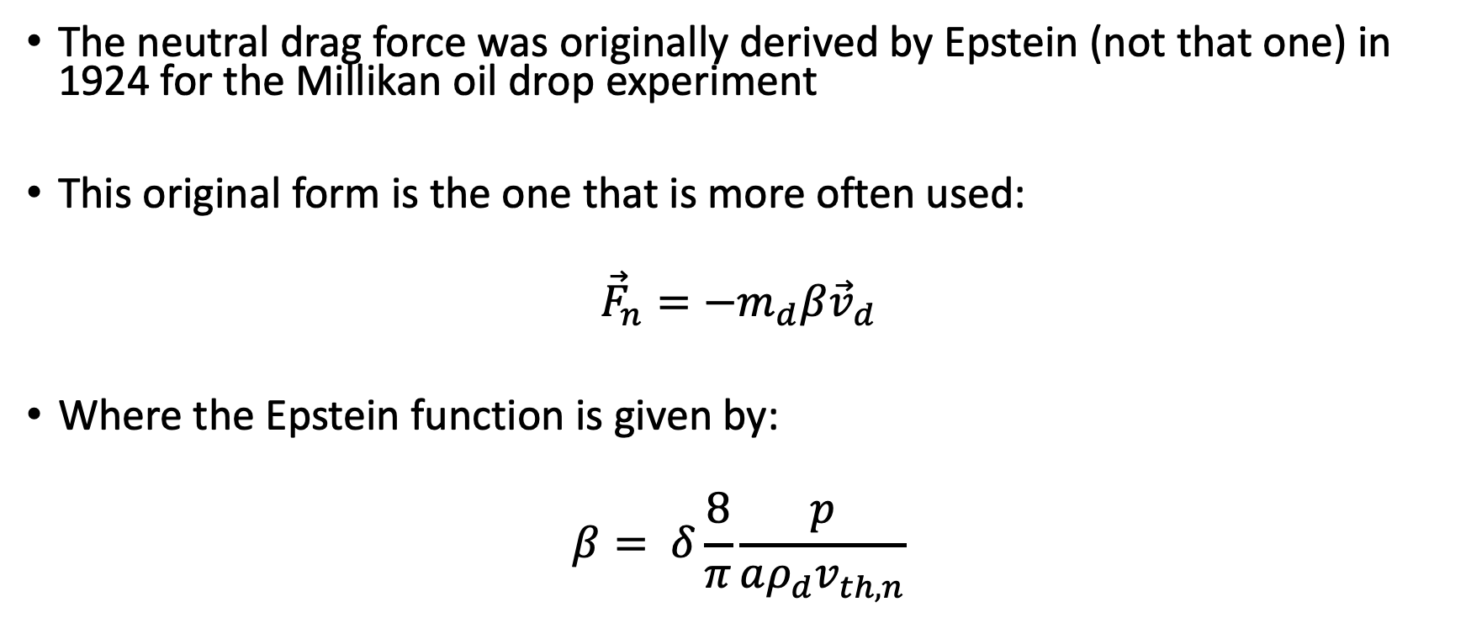
Neutral Drag Force
The neutral drag force was originally derived by Epstein (not that one) in 1924 for the Millikan oil drop experiment
This original form is the one that is more often used:
$${\vec{F}}_{n}=−m_{d}β{\vec{v}}_{d}$$
Where the Epstein function is given by:
$$β= δ\frac{8}{π}\frac{p}{aρ_{d}v_{th, n}}$$

Slide 23
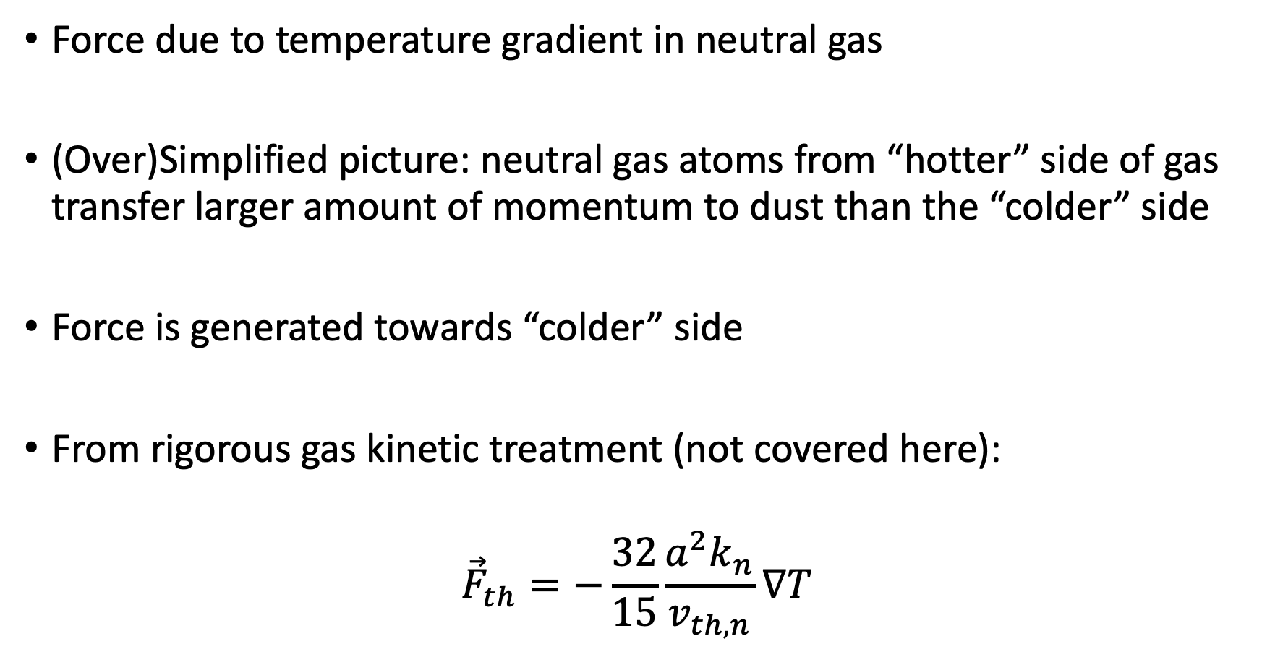
Thermophoresis
Force due to temperature gradient in neutral gas
(Over)Simplified picture: neutral gas atoms from “hotter” side of gas transfer larger amount of momentum to dust than the “colder” side
Force is generated towards “colder” side
From rigorous gas kinetic treatment (not covered here):
$${\vec{F}}_{th}=−\frac{32}{15}\frac{a^{2}k_{n}}{v_{th, n}}∇T$$

Slide 24
Laser Forces
Focused laser beams used to manipulate dust particles
Force pushes dust particle in direction of beam
Origin of laser source due to two sources
Radiation Pressure
Photophoretic Force

Slide 25
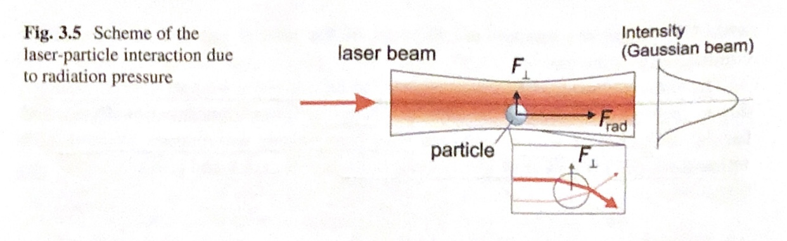
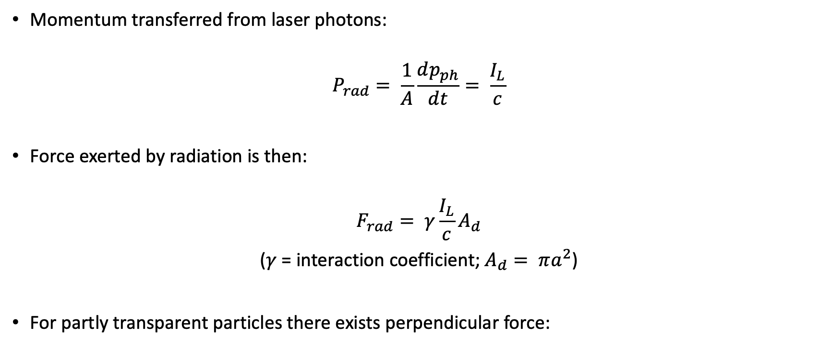
Radiation Pressure
Momentum transferred from laser photons:
$$P_{rad}= \frac{1}{A}\frac{dp_{ph}}{dt}= \frac{I_{L}}{c}$$
Force exerted by radiation is then:
$$F_{rad}= γ\frac{I_{L}}{c}A_{d}$$
($γ$ = interaction coefficient; $A_{d}= πa^{2}$)
For partly transparent particles there exists perpendicular force:
Image Source [1].

Slide 26
Photophoretic
Much more difficult to analyze
It is assumed that laser heats the illuminated particle
This creates a thermophoretic-like force on the particle
This leads to a force away from “hot” side of particle
However: Temperature distribution across particle VERY difficult to determine

Slide 27
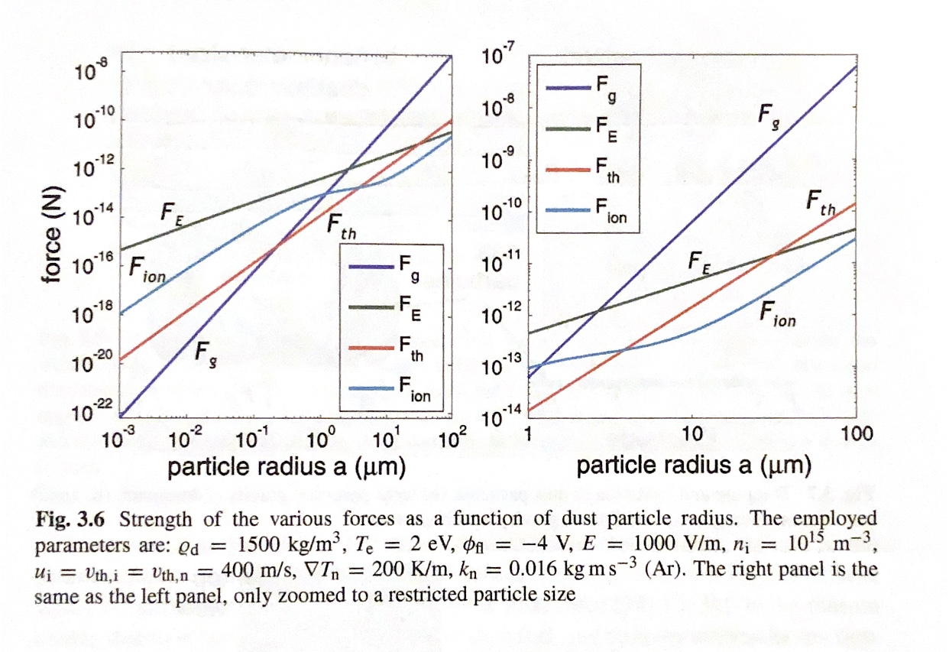
Compilation of Forces
Image Source [1].

Slide 28
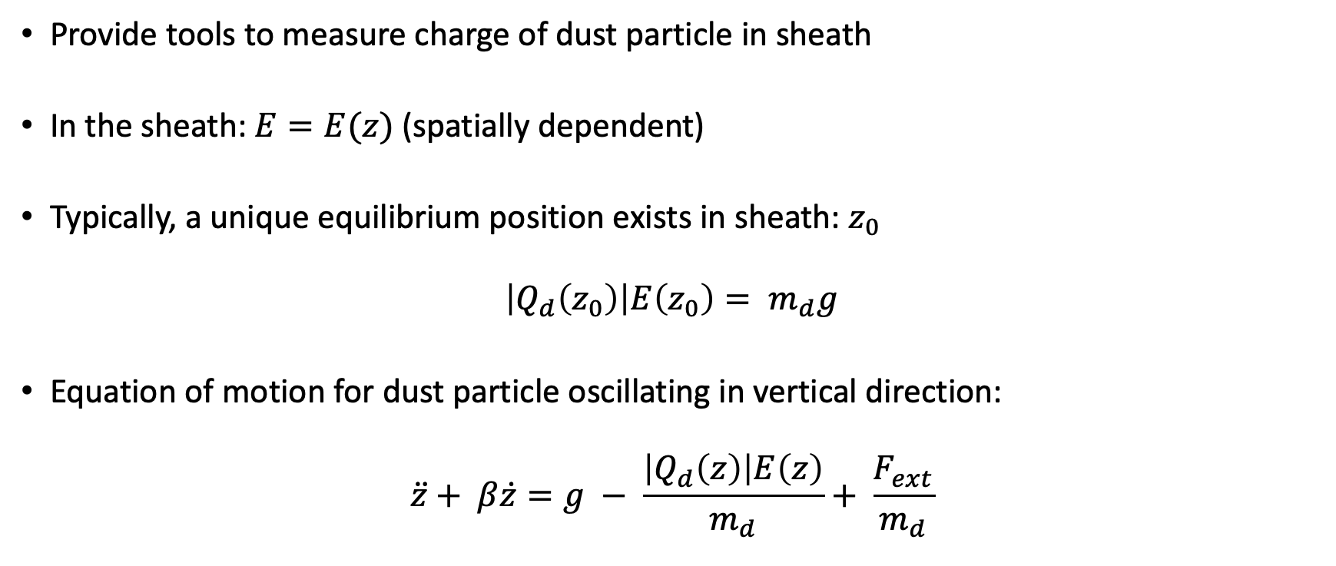
Vertical Oscillations
Provide tools to measure charge of dust particle in sheath
In the sheath: $E=E(z)$ (spatially dependent)
Typically, a unique equilibrium position exists in sheath: $z_{0}$
$$\left|Q_{d}\left(z_{0}\right)\right|E\left(z_{0}\right)= m_{d}g$$
Equation of motion for dust particle oscillating in vertical direction:
$$\ddot{z}+ β\dot{z}=g − \frac{\left|Q_{d}\left(z\right)\right|E\left(z\right)}{m_{d}}+ \frac{F_{ext}}{m_{d}}$$

Slide 29
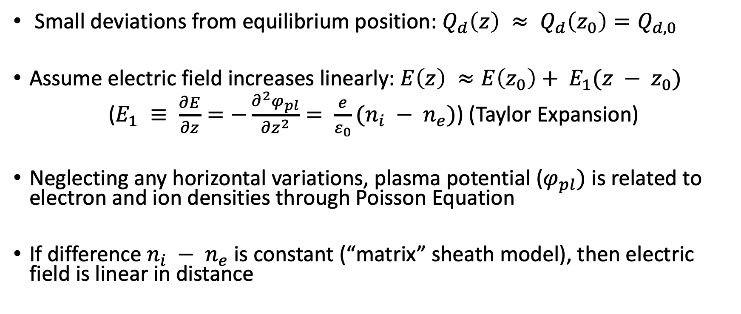
Laser Resonance and Charge Measurement
Small deviations from equilibrium position: $Q_{d}\left(z\right) ≈ Q_{d}\left(z_{0}\right)=Q_{d,0}$
Assume electric field increases linearly: $E\left(z\right) ≈E\left(z_{0}\right)+ E_{1}(z − z_{0})$
($E_{1} ≡ \frac{∂E}{∂z}=−\frac{∂^{2}φ_{pl}}{{∂z}^{2}}= \frac{e}{ε_{0}}(n_{i} − n_{e})$) (Taylor Expansion)
Neglecting any horizontal variations, plasma potential ($φ_{pl})$ is related to electron and ion densities through Poisson Equation
If difference $n_{i} − n_{e}$ is constant (“matrix” sheath model), then electric field is linear in distance

Slide 30
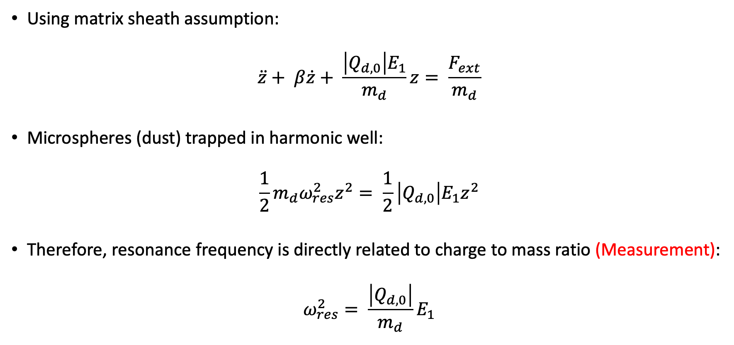
Laser Resonance and Charge Measurement
Using matrix sheath assumption:
$$\ddot{z}+ β\dot{z}+ \frac{\left|Q_{d,0}\right|E_{1}}{m_{d}}z= \frac{F_{ext}}{m_{d}}$$
Microspheres (dust) trapped in harmonic well:
$$\frac{1}{2}m_{d}ω_{res}^{2}z^{2}= \frac{1}{2}\left|Q_{d,0}\right|E_{1}z^{2}$$
Therefore, resonance frequency is directly related to charge to mass ratio (Measurement):
$$ω_{res}^{2}= \frac{\left|Q_{d,0}\right|}{m_{d}}E_{1}$$

Slide 31
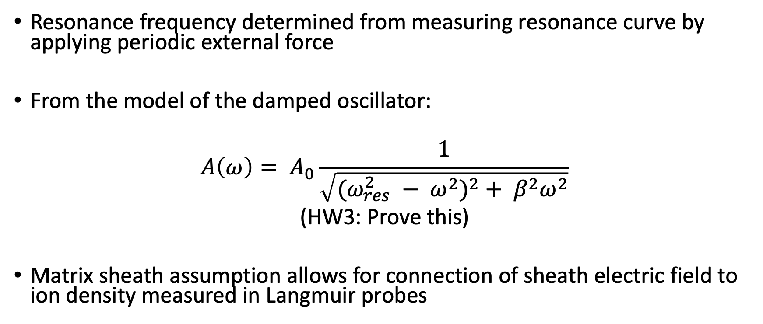
Laser Resonance and Charge Measurement
Resonance frequency determined from measuring resonance curve by applying periodic external force
From the model of the damped oscillator:
$$A\left(ω\right)= A_{0}\frac{1}{\sqrt{(ω_{res}^{2} − ω^{2})^{2}+ β^{2}ω^{2}}}$$
(HW3: Prove this)
Matrix sheath assumption allows for connection of sheath electric field to ion density measured in Langmuir probes

Slide 32
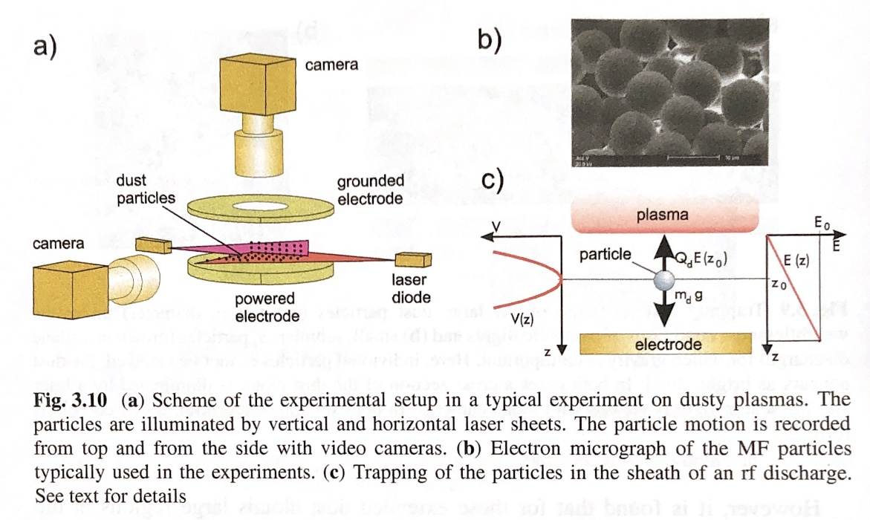
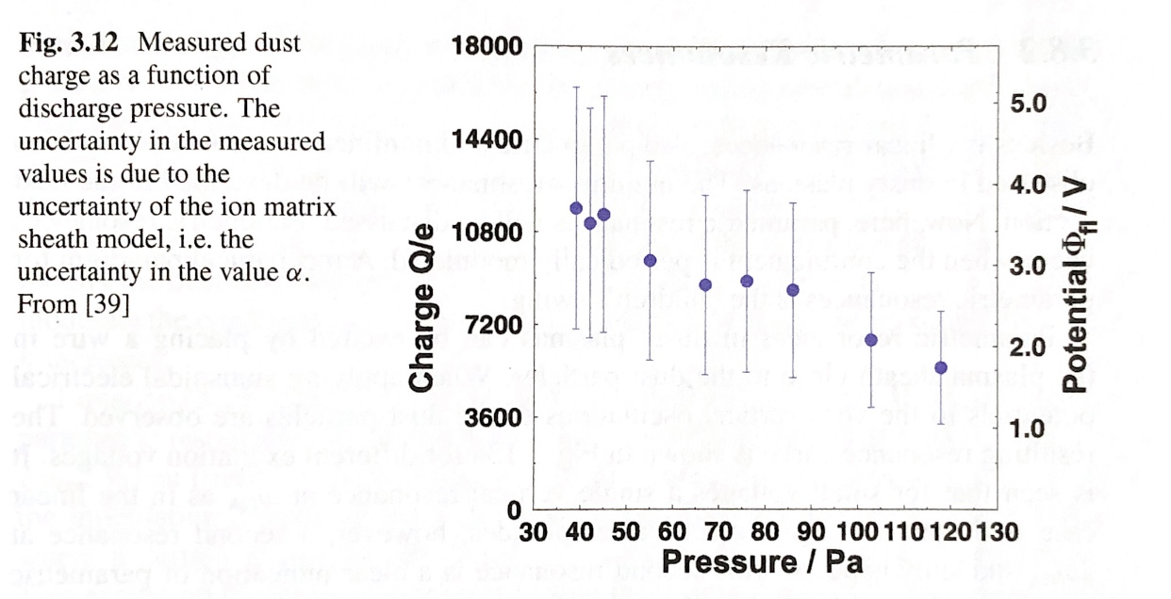
Laser Resonance and Charge Measurement Layout
Image Source [1].
Image Source [1].

Slide 33
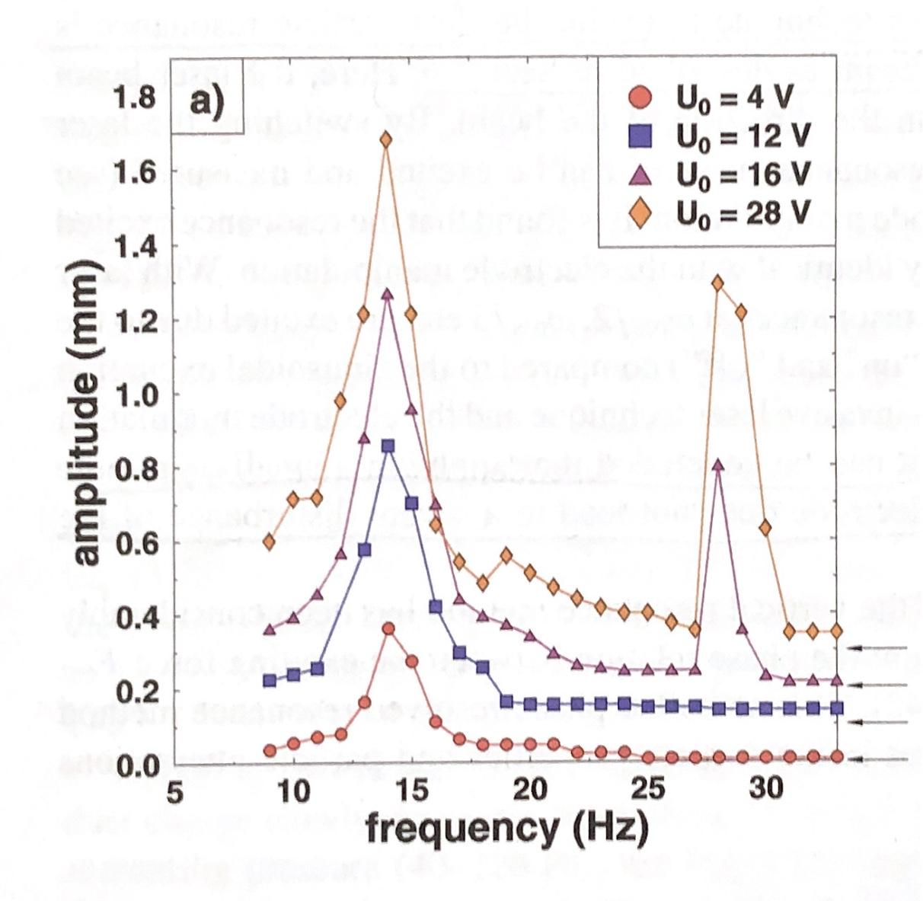
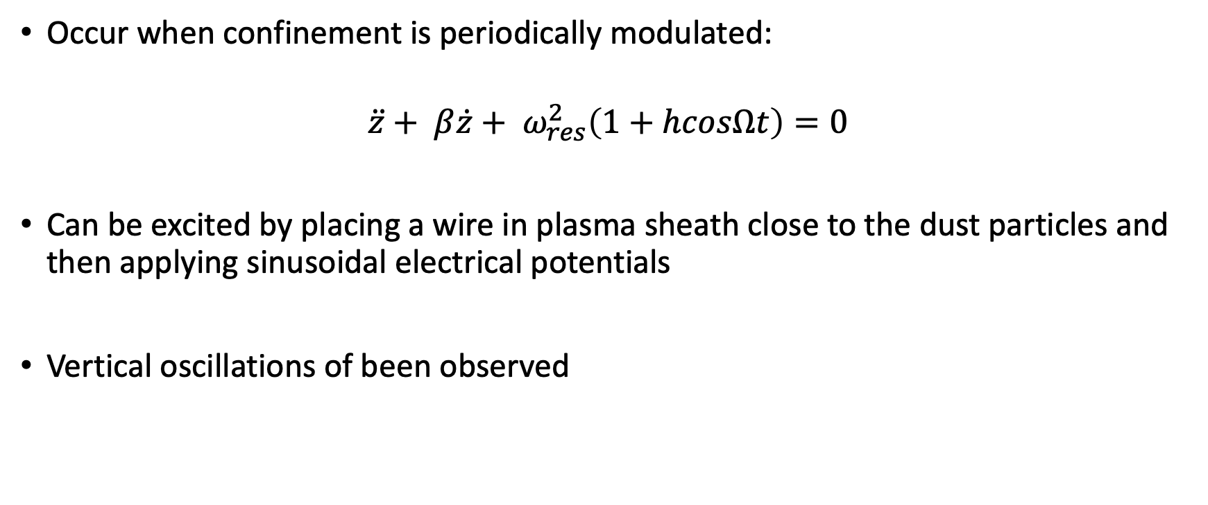
Parametric Resonances
Occur when confinement is periodically modulated:
$$\ddot{z}+ β\dot{z}+ ω_{res}^{2}\left(1+hcosΩt\right)=0$$
Can be excited by placing a wire in plasma sheath close to the dust particles and then applying sinusoidal electrical potentials
Vertical oscillations of been observed
Image Source [1].

Slide 34
Nonlinear Resonances
Include nonlinear terms in expansion of electric field
Electric field is only linear in matrix sheath model
In presheath ions are accelerated to Bohm velocity
At sheath edge ion velocity further increases by acceleration in sheath electric field
This leads to higher negative potential on dust grains
Deep in the sheath electron density is drastically decreased leading higher positive charge on dust

Slide 35
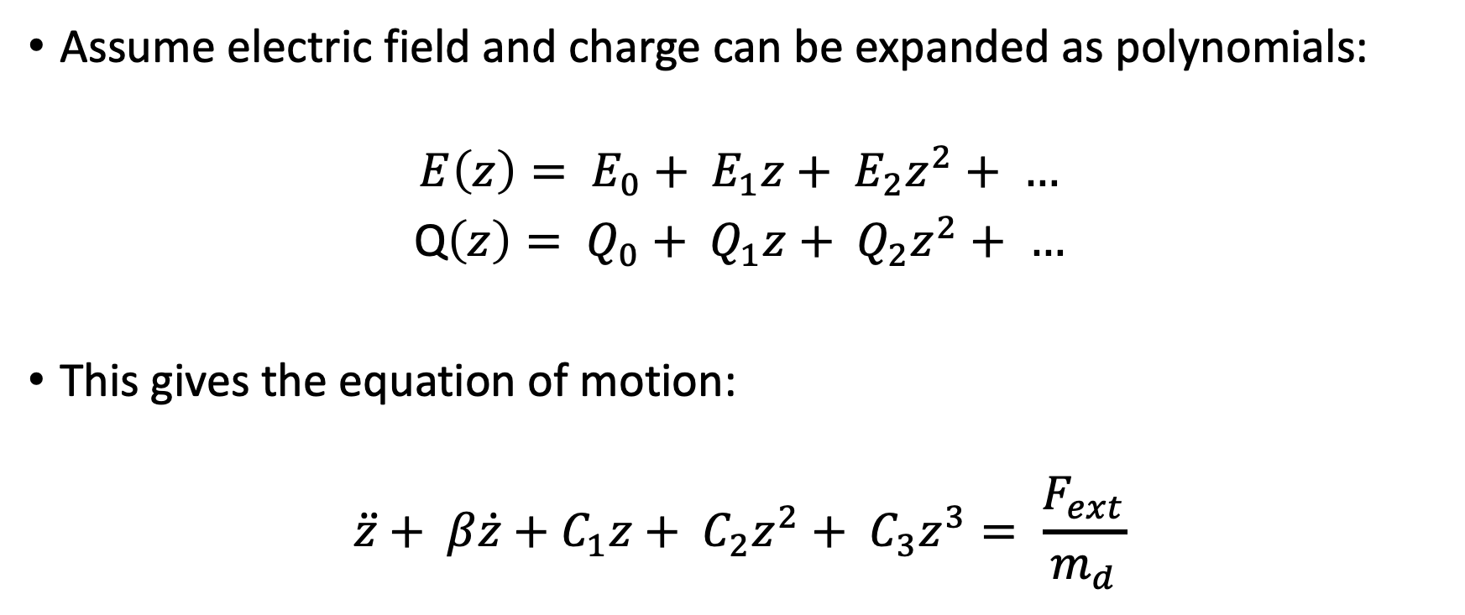
Nonlinear Resonances
Assume electric field and charge can be expanded as polynomials:
$$E\left(z\right)= E_{0}+ E_{1}z+ E_{2}z^{2}+ …$$
Q$\left(z\right)= Q_{0}+ Q_{1}z+ Q_{2}z^{2}+ …$
This gives the equation of motion:
$$\ddot{z}+ β\dot{z}+C_{1}z+ C_{2}z^{2}+ C_{3}z^{3}= \frac{F_{ext}}{m_{d}}$$

Slide 36
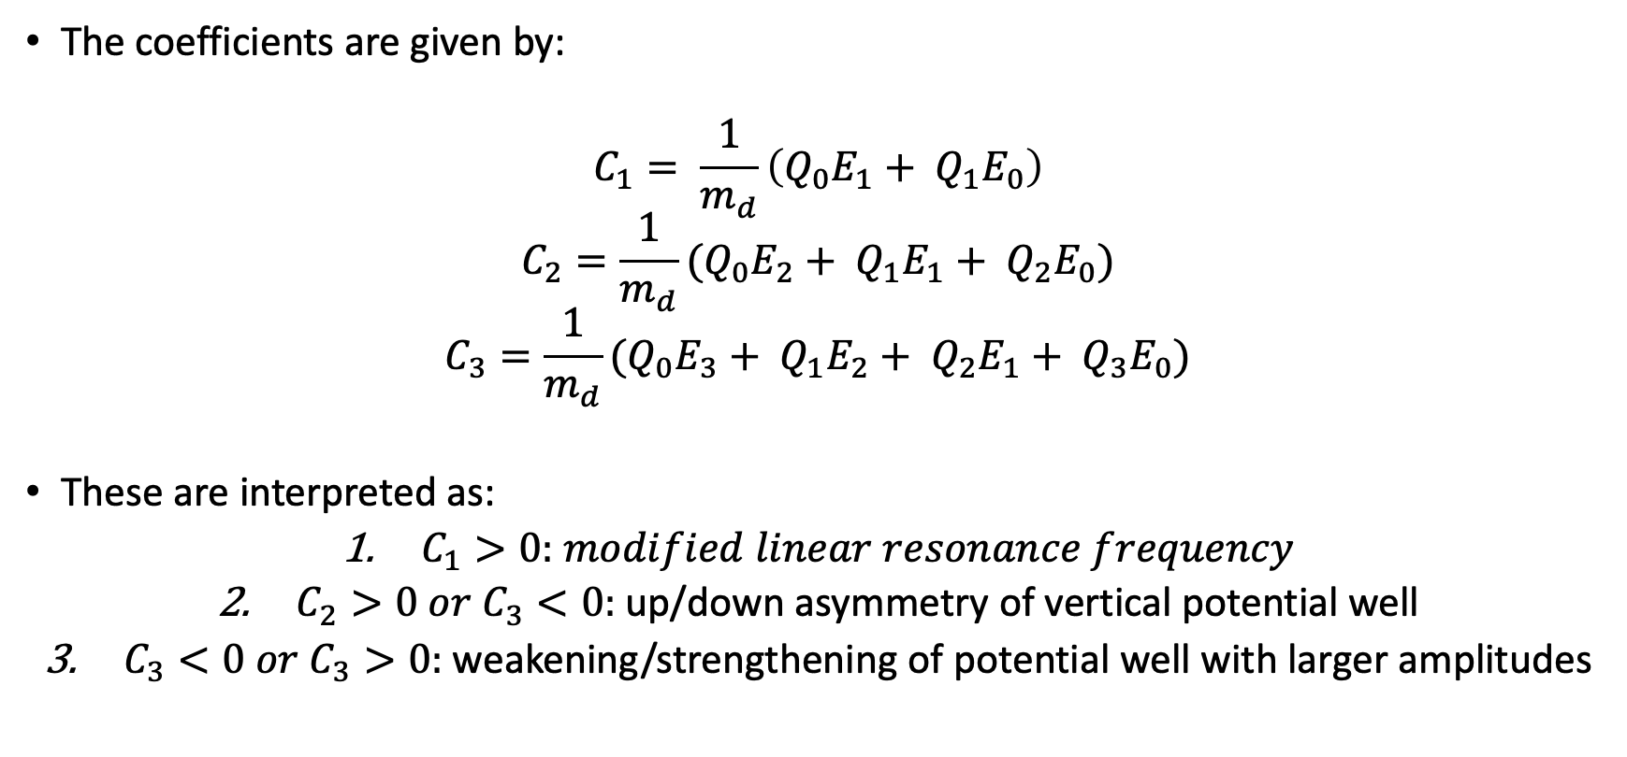
Nonlinear Resonances
The coefficients are given by:
$$C_{1}= \frac{1}{m_{d}}\left(Q_{0}E_{1}+ Q_{1}E_{0}\right)$$
$$C_{2}=\frac{1}{m_{d}}(Q_{0}E_{2}+ Q_{1}E_{1}+ Q_{2}E_{0})$$
$$C_{3}=\frac{1}{m_{d}}(Q_{0}E_{3}+ Q_{1}E_{2}+ Q_{2}E_{1}+ Q_{3}E_{0})$$
These are interpreted as:
$C_{1}>0:$ $modified linear resonance frequency$
$C_{2}>0 or C_{3}<0:$ up/down asymmetry of vertical potential well
$C_{3}<0 or C_{3}>0:$ weakening/strengthening of potential well with larger amplitudes

Slide 37
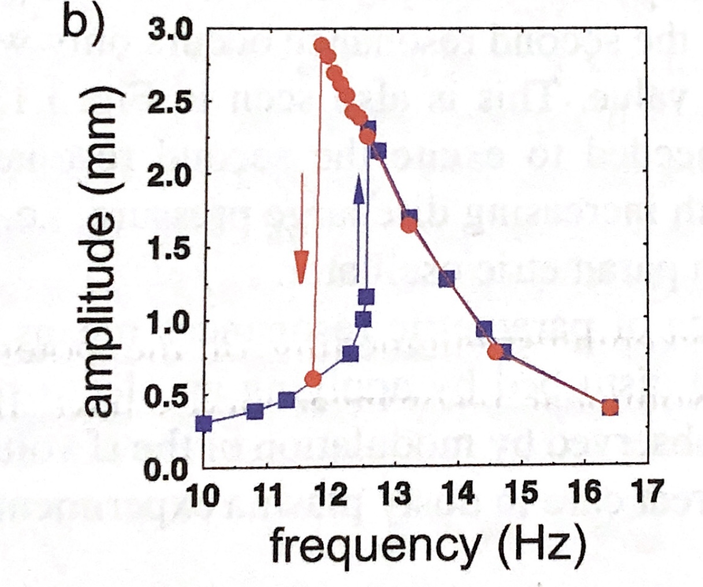
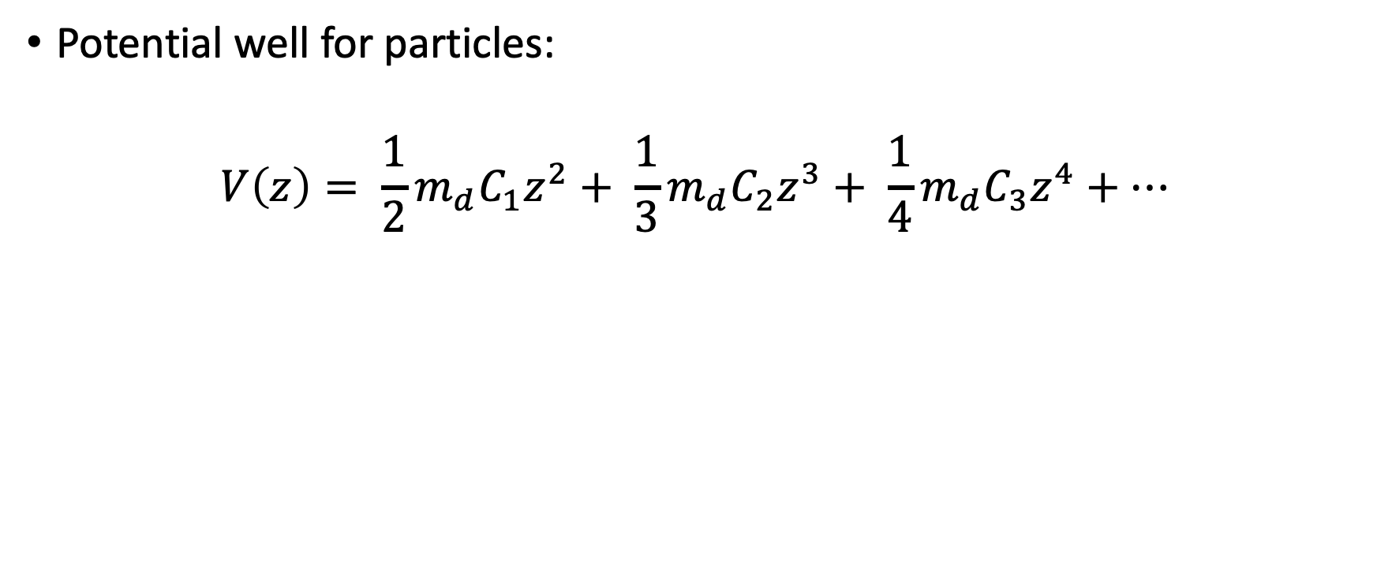
Nonlinear Resonances
Potential well for particles:
$$V\left(z\right)= \frac{1}{2}m_{d}C_{1}z^{2}+ \frac{1}{3}m_{d}C_{2}z^{3}+ \frac{1}{4}m_{d}C_{3}z^{4}+…$$
Image Source [1].

Slide 38
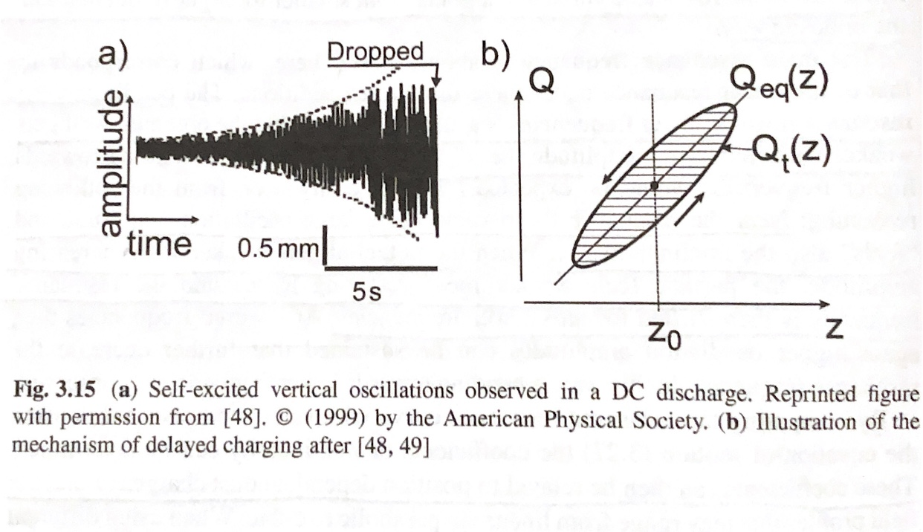
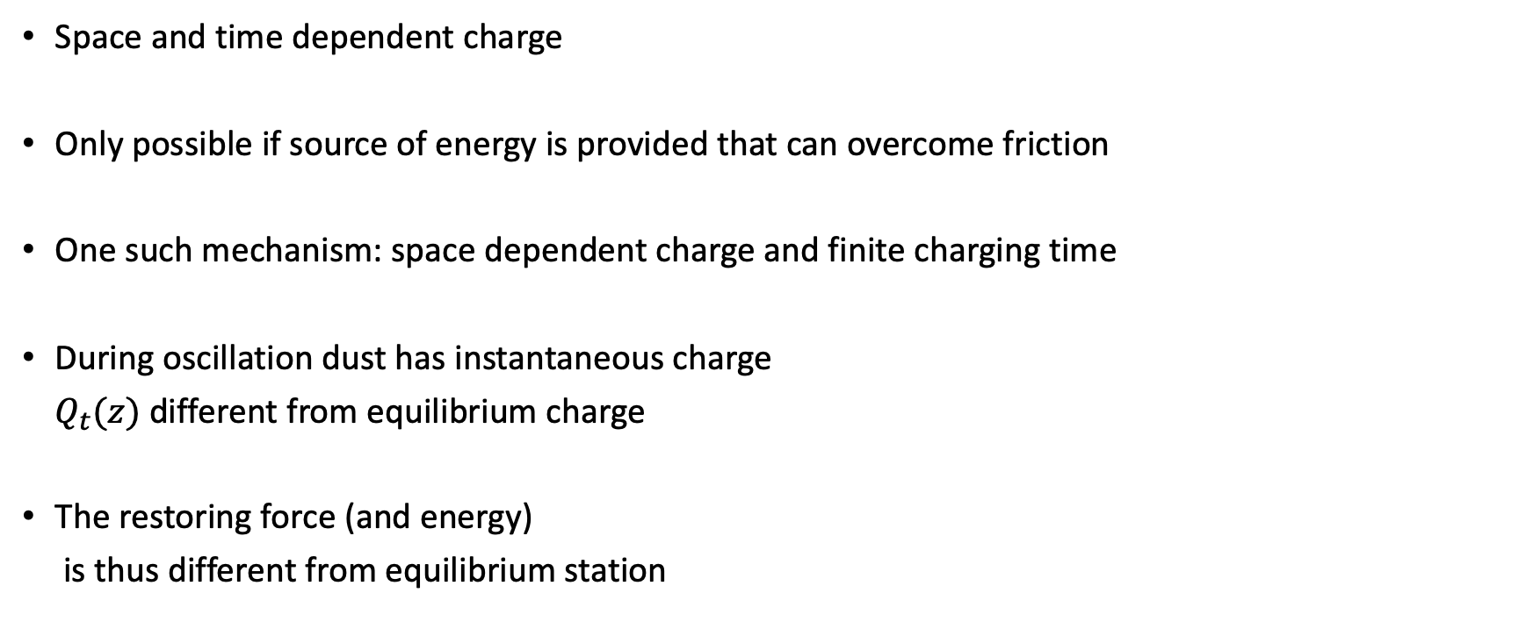
Delayed Charging
Space and time dependent charge
Only possible if source of energy is provided that can overcome friction
One such mechanism: space dependent charge and finite charging time
During oscillation dust has instantaneous charge
$Q_{t}(z)$ different from equilibrium charge
The restoring force (and energy)
is thus different from equilibrium station
Image Source [1].

Slide 39
Sources
A. Meltzer, Physics of Dusty Plasmas (Springer Nature Switzerland, 2019).
M.S. Barnes, et. al., Phys. Rev. Lett. 68, 313 (1992).
R J. Goldston, Introduction to Plasma Physics (Taylor and Francis Group LLC, 1995).

Slide 40
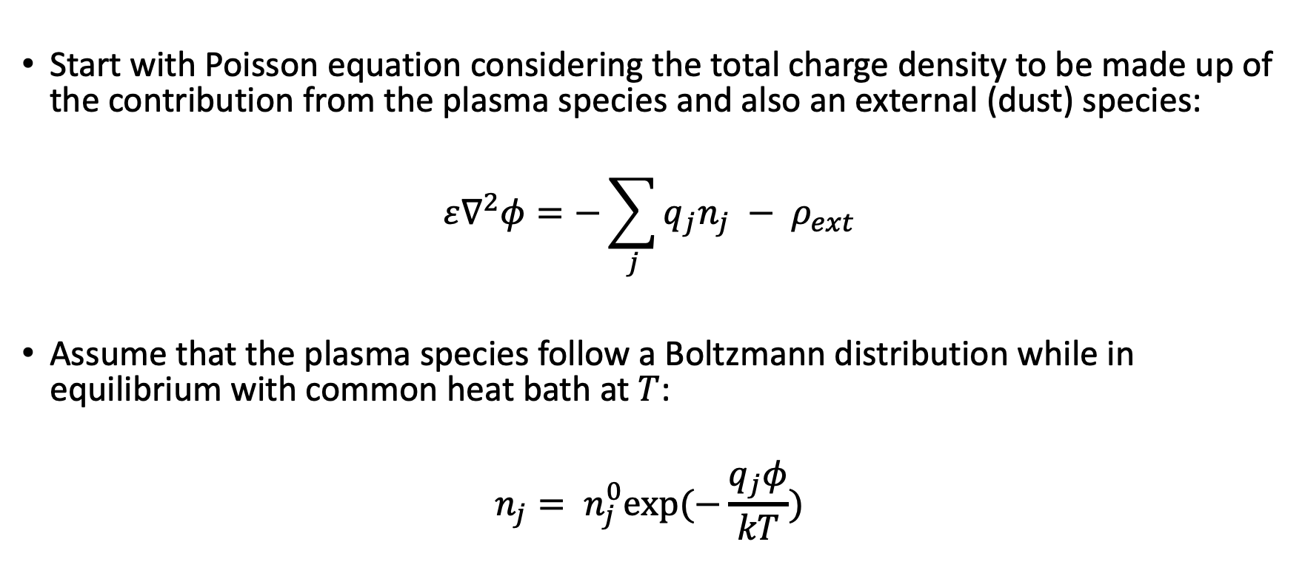
Debye-Huckel Equation
Start with Poisson equation considering the total charge density to be made up of the contribution from the plasma species and also an external (dust) species:
$$ε∇^{2}φ=−\sum_{j}{q_{j}n_{j} − ρ_{ext}}$$
Assume that the plasma species follow a Boltzmann distribution while in equilibrium with common heat bath at $T$:
$$n_{j}= n_{j}^{0}exp⁡(−\frac{q_{j}φ}{kT})$$

Slide 41
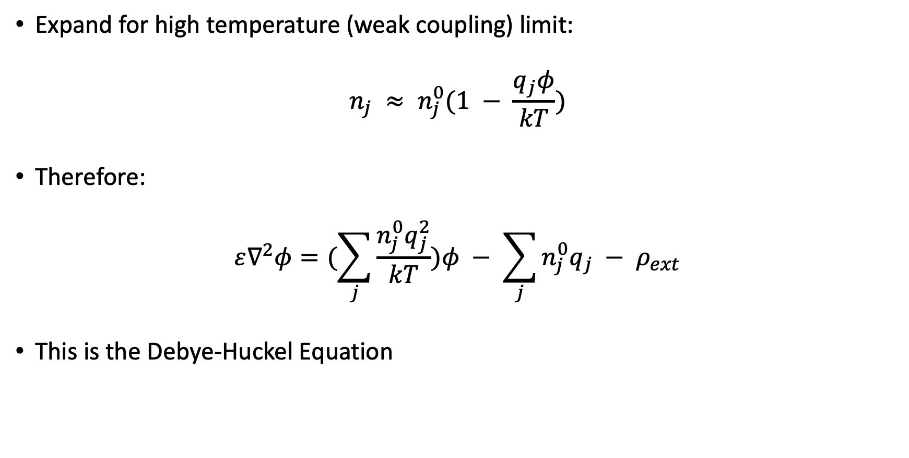
Debye-Huckel Equation
Expand for high temperature (weak coupling) limit:
$$n_{j} ≈ n_{j}^{0}(1 − \frac{q_{j}φ}{kT})$$
Therefore:
$$ε∇^{2}φ=(\sum_{j}{\frac{n_{j}^{0}q_{j}^{2}}{kT})φ − \sum_{j}{n_{j}^{0}q_{j} − ρ_{ext}}}$$
This is the Debye-Huckel Equation

Slide 42
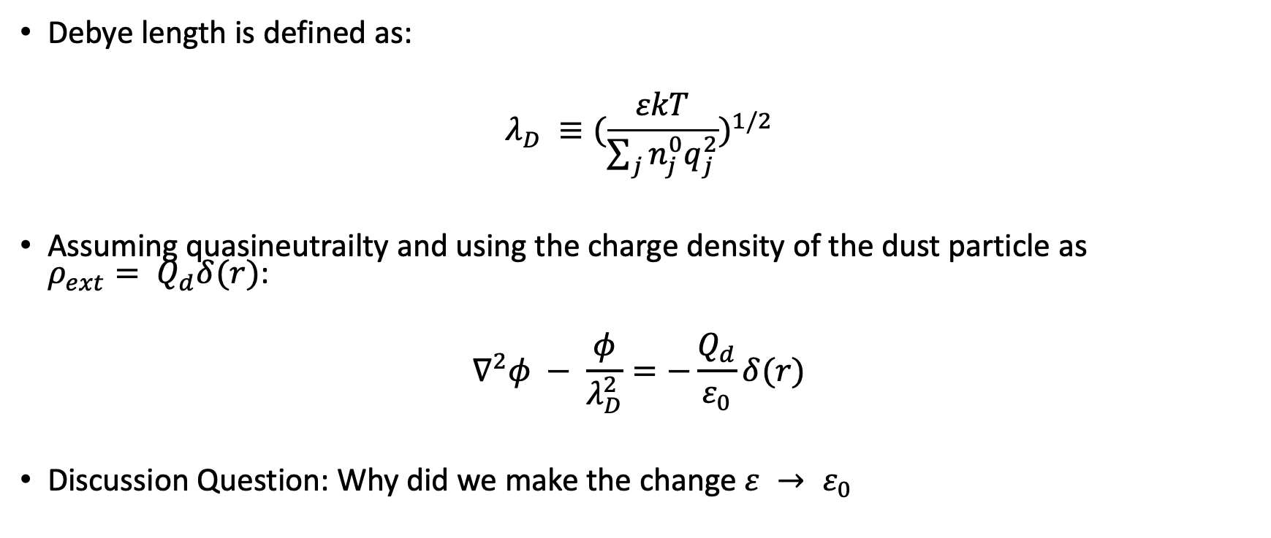
Debye-Huckel Equation
Debye length is defined as:
$$λ_{D} ≡(\frac{εkT}{\sum_{j}{n_{j}^{0}q_{j}^{2}}})^{1/2}$$
Assuming quasineutrailty and using the charge density of the dust particle as $ρ_{ext}= Q_{d}δ(r)$:
$$∇^{2}φ − \frac{φ}{λ_{D}^{2}}=−\frac{Q_{d}}{ε_{0}}δ(r)$$
Discussion Question: Why did we make the change $ε → ε_{0}$

